Slide 1

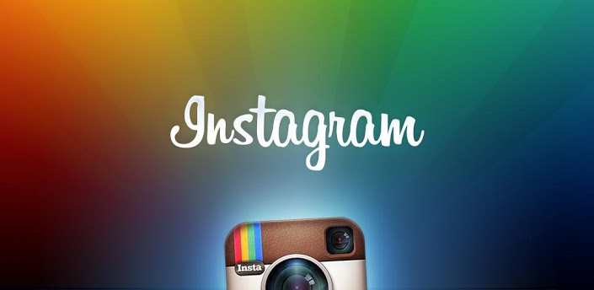
Entrepreneurship: A Case Study

Slide 2
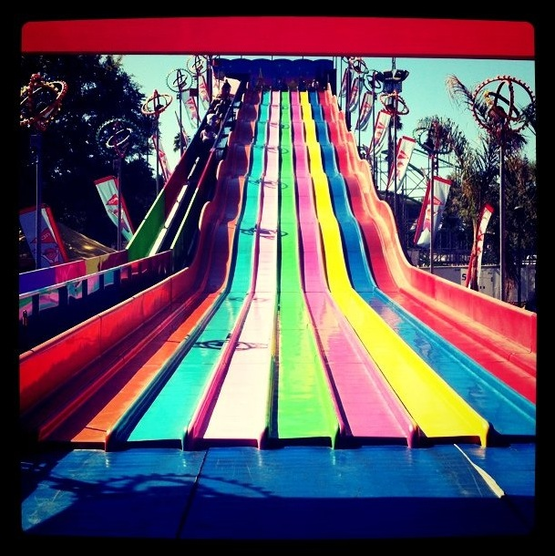
What is Instagram?
App
Social network
Photo sharing service

Slide 3
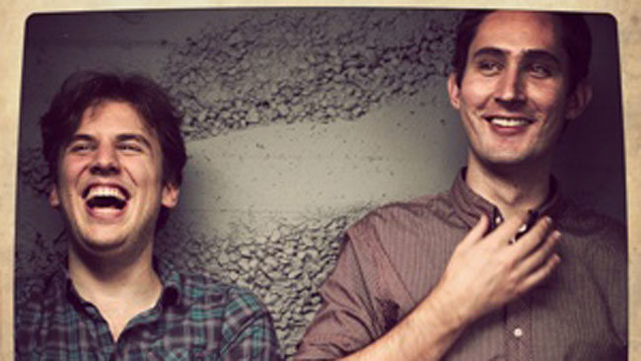
Founders
Kevin Systrom
  Stanford
  Google
  Nextstop
Mike Krieger
  Stanford

Slide 4
Law of Zeros
Each new generation of technology shifts by one zero
Personal Computers
    $ 0,000
    Units: 0,000,000
  Personal Digital Assistants
      $ 000
      Units: 00,000,000
    Cell Phones
        $ 00
        Units: 000,000,000
      Apps
        $ 0
        Units: 0,000,000,000

Slide 5



Why Create Instagram?

Slide 6
Simplicity & Mobility
Instagram is a simple point-and-shoot photo sharing service based on a mobile platform

Slide 7
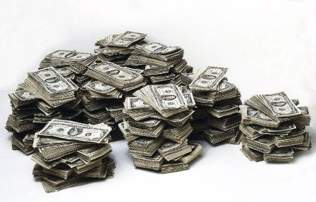
Funding
Angels - $ 500,000
Series A - $ 7 Million
Series B - $ 50 Million

Slide 8
Instagram User Base
The Instagram user base has increased almost exponentially.
    April 2012: 40 Million Users
      June 2011: 5 Million Users
    January 2011: 1 Million Users
  November 2010: 100,000 Users
October 2010: Instagram Launched

Slide 9
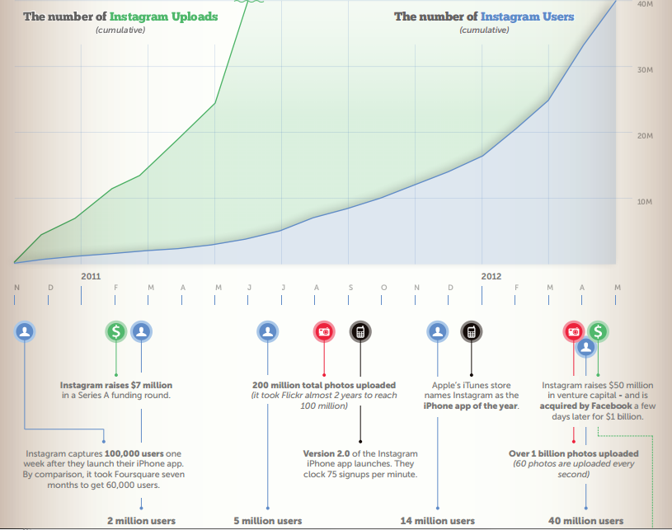

Slide 10
Strategies

Slide 11
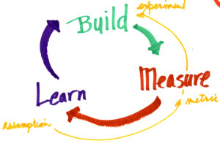
Lean Startups
Scientific experimentation
Iterative product releases
Customer input

Slide 12

Iterative Product Release
Prevent wasteful practices
Notes:
Instagram stayed a team of 4 for a long time

Slide 13
Customer Participation
Get customer feedback as the product is being developed
  Focus on long-term customers
Pivot
  structured course correction
  Its always the founders’ belief that their initial idea is what will takeoff
  Falling in love with the problem not the solution

Slide 14
“Lean has nothing to do with how much money a company raises. Rather, it has everything to do with assessing the specific demands of consumers and how to meet that demand using the least amount of resources possible.”
- Eric Ries

Slide 15
Instagram’s Acquisition
Facebook officially acquired Instagram on September 6th of this year
The deals were carried out by the CEOs of both companies and according to Facebook’s head of corporate development, did not involve investment bankers or financial advisors

Slide 16
Acquisition Details
The media implied it was acquired for 1 billion but that isn’t really true since it’s based largely on stock price
Facebook offered Instagram a cash incentive of $300 million as well as 23 million shares (originally valued at $31 dollars a piece)
Today it’s approximately worth 750 million. (with current stock evaluation at 19.50)

Slide 17
Who wins?
Instagram didn’t actually make a profit before the Facebook acquisition, so for them they had nothing to lose and tons to gain
With a large percentage of Facebook’s user base using mobile devices, the ability to integrate a popular photo sharing service into Facebook is a huge plus. However, $1 billion is lots of money

